Slide 1
Paint Loss Detection in Old Paintings by Sparse Representation Classification
Shaoguang Huang, Wenzhi Liao, Hongyan Zhang and Aleksandra Pizurica
Statistical Image Modeling Lab
Image Processing and Interpretation (IPI) group
Department Telecommunications and Information Processing
ITWIST 2016
25/08/2016

Slide 2
Outline
Problem
Sparse representation classification
Paint loss detection method
Evaluation
Conclusion

Slide 3
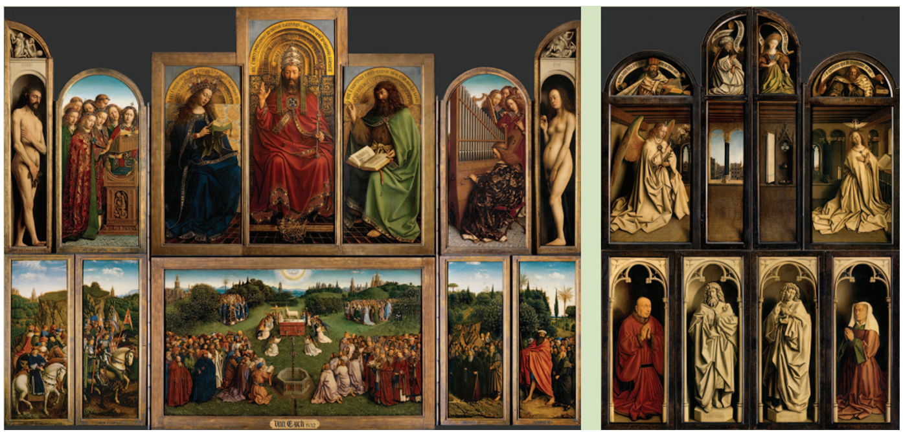
Case study
The Ghent Altarpiece, Hubert and Jan Van Eyck,
completed in 1432.

Slide 4
Current restoration treatment
Restoration campaign (KIK-IRPA) started in 2012.

Slide 5
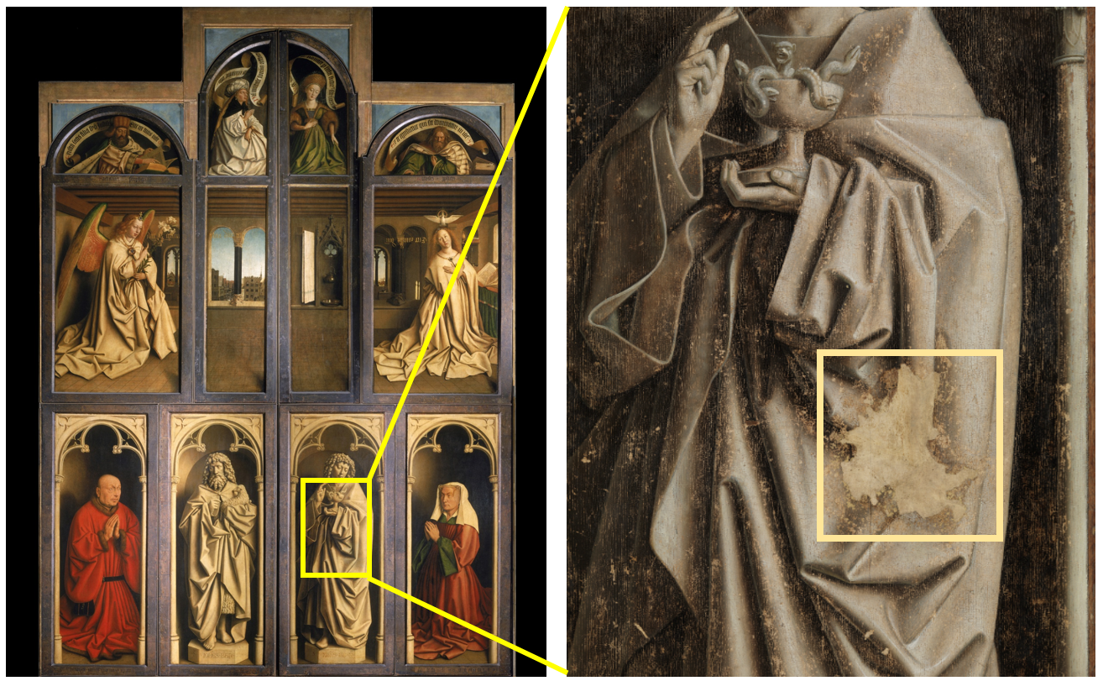
Paint losses
Paint losses revealed after removing the overpaint.
5

Slide 6
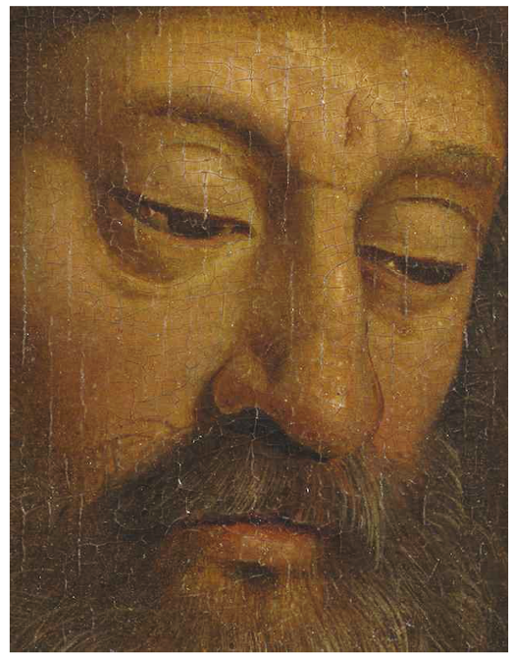
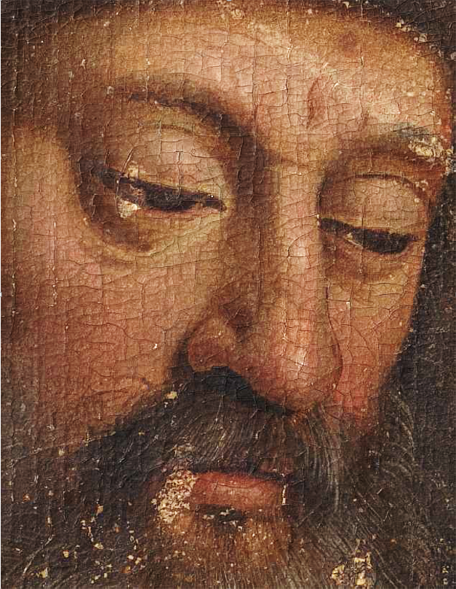
Other examples of paint loss
Before cleaning
After cleaning

Slide 7
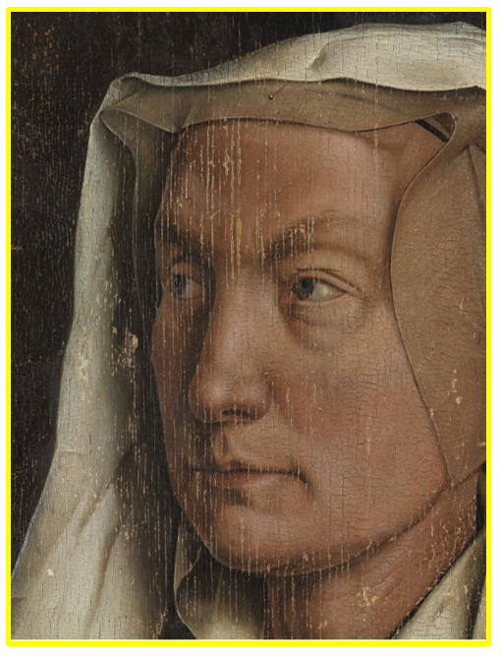
Problem
Paint loss detection crucial for:
Documenting purpose
Input for virtual restoration
Decision making in the real restoration campaign
Currently done manually:
Labor intensive
Prone to errors

Slide 8
Outline
Problem
Sparse representation classification
Paint loss detection method
Evaluation
Conclusion

Slide 9
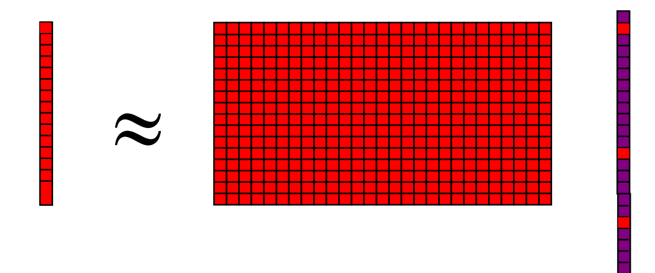
Sparse Coding
Model:
$y≈Dα$=$\sum_{i=1}^{L}{d_{i}α_{i}}$
Objective: $\hat{ α}=arg\min_{α}{{\left\|α\right\|}_{0} subject to y=Dα }$
${\left\|α\right\|}_{0}$ indicates the number of nonzero elements in $α$.
Solvers: relaxation or greedy algorithms.
$$α$$
D=[$d_{1}$, $d_{2},…,d_{L}$]
$$y∈ℝ^{m}$$
D$∈ℝ^{m×L}$
$$α∈ℝ^{L}$$

Slide 10
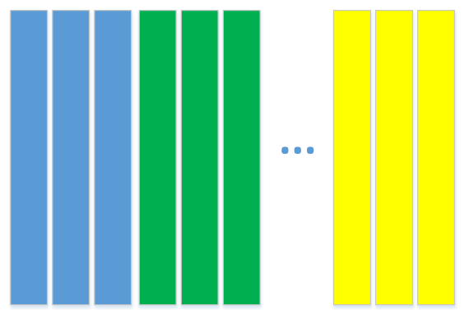
Sparse Representation Classification
$$e_{i}(y)={\left\|y−D_{i}α_{i}\right\|}_{2}$$
$$identity(y)=arg\min_{i}{e_{i}(y)}$$
is the coding coefficient vector associated with class $i$.
J. Wright et al., IEEE TPAMI, Feb. 2009.
y and D
D=
$$D_{1}$$
$$D_{2}$$
$$D_{c}$$
Sparse coding
$$α$$
Class-specific residuals
$$e_{i}(y)$$
Identify
$$α_{i}$$

Slide 11
Outline
Problem
Sparse representation classification
Paint loss detection method
Evaluation
Conclusion

Slide 12
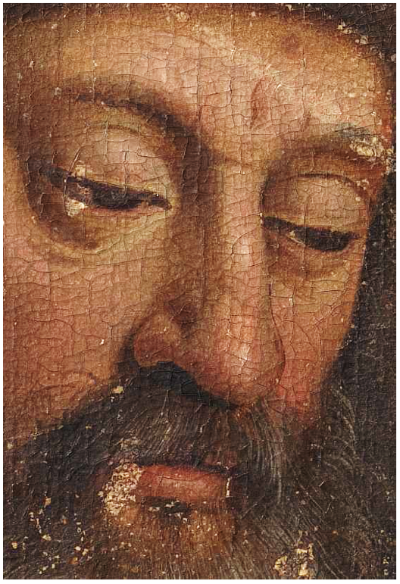
Applying SRC to our problem
General ideas:
Binary classification.
Class one: Paint loss
Class two: Other
Construct dictionary from well-designed features.
Deal with the unreliable training samples.

Slide 13
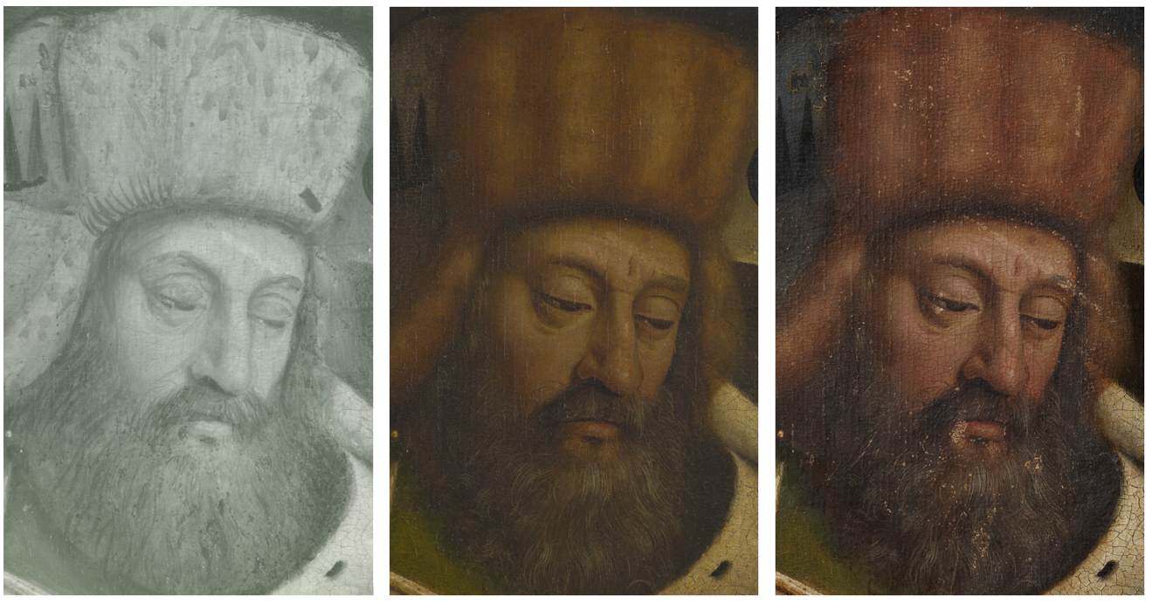
Image sources
Infrared image before cleaning
Visible image before cleaning
Visible image after cleaning

Slide 14
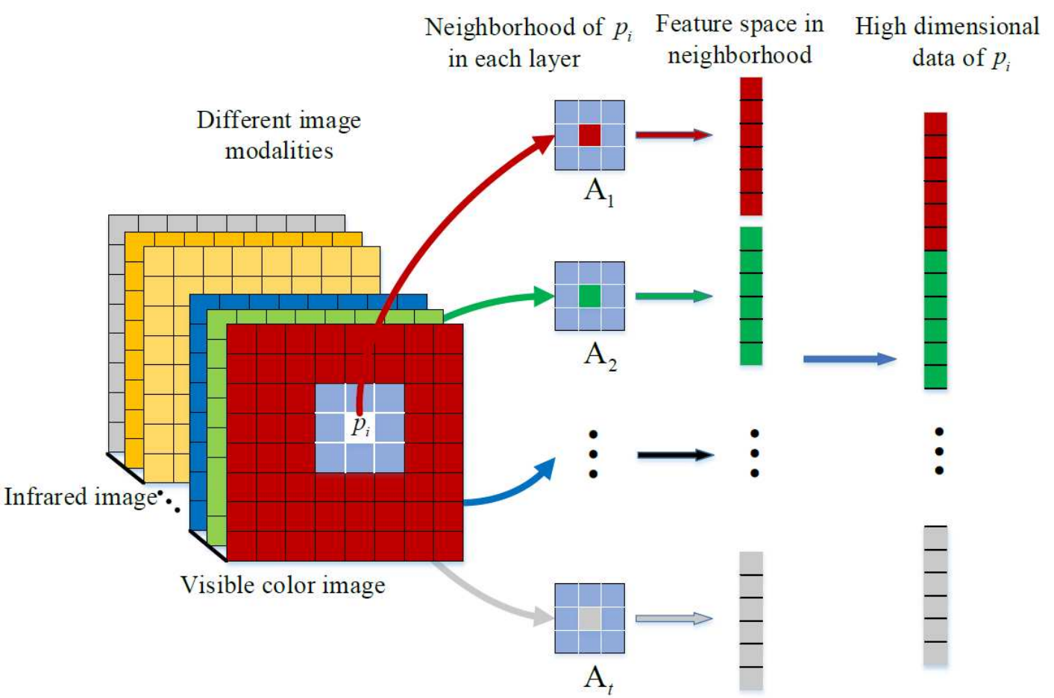
Feature Generation
Neighborhood matrix
Feature vectors
Features:
mean, variance, range, correlations ($AA^{T}$and $A^{T}A$).
$$f_{1,i}$$
Layer t
$$f_{2,i}$$
Layer 1
$$f_{l,i}=\left[f_{l,i,1}, f_{l,i,2},…,f_{l,i,Q}\right]$$
$$y_{i}=[f_{1,i}, f_{2,i},…,f_{t,i}]$$
Infrared image
Visible color image
$$f_{t,i}$$
$$y_{i}$$

Slide 15
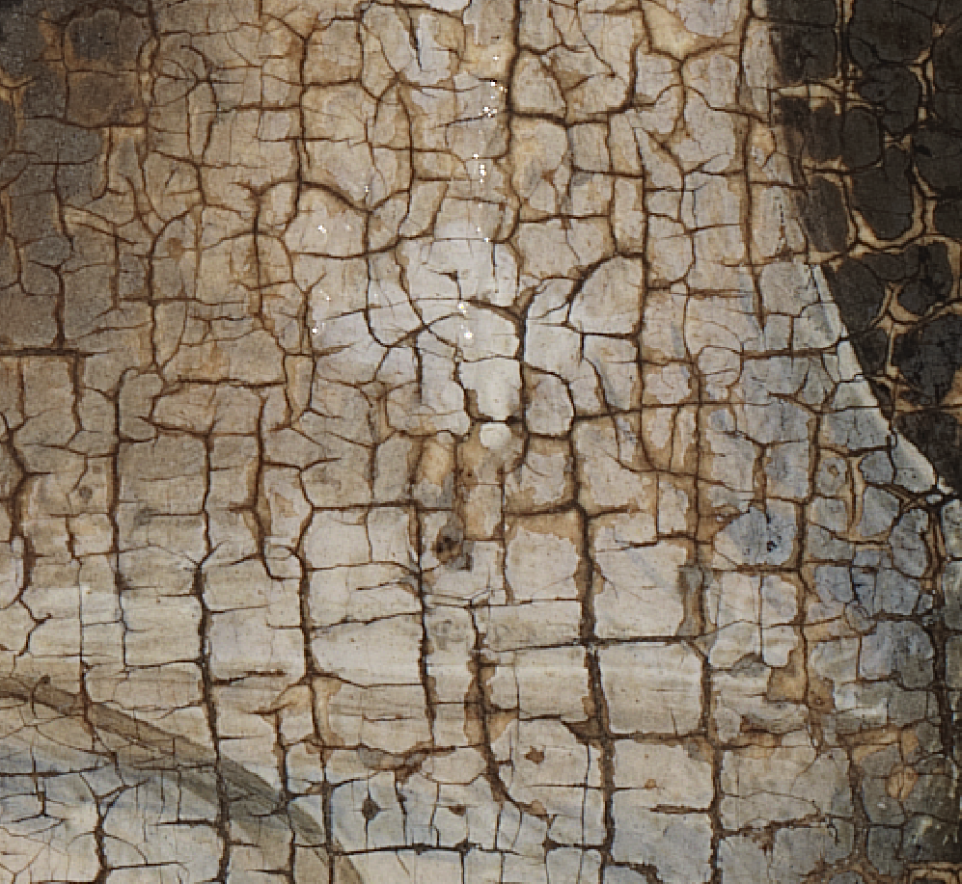
Detection method
.
.
.
part
.
.
.
part
Construct Dictionary
Classification result
Output class
SRC
$$identity\left(y\right)=arg\max_{c}{p_{y}^{c}}$$
$$p_{y}^{c}=N_{y}^{c}/K$$
$$c∈\left\{loss, nonloss\right\}$$
Generate feature space
Repeat K times

Slide 16
Reference classifiers
Linear regression (LR)
$$\hat{W}=arg\min_{W}{{\left\|H−WY\right\|}_{2}^{2}+}β{\left\|W\right\|}_{2}$$
$H=\left[h_{1},h_{2},…,h_{N}\right]∈ℝ^{2×N},h_{i}={\left[0,1\right]}^{T}$ or ${\left[1,0\right]}^{T}$,
$W∈ℝ^{2×M}$, $Y∈ℝ^{M×N}$.
$$\hat{W}={{(Y}^{T}Y+βI)}^{−1}YH^{T}$$
SVM classifier
LibSVM-toolbox.
https://www.csie.ntu.edu.tw/~cjlin/libsvm/

Slide 17
Outline
Problem
Sparse representation classification
Paint loss detection method
Evaluation
Conclusion

