Slide 1
Example 1
“Prophet Zachariah” in The Ghent Altarpiece. Size: 1945×1248.
Notes:
45522

Slide 2
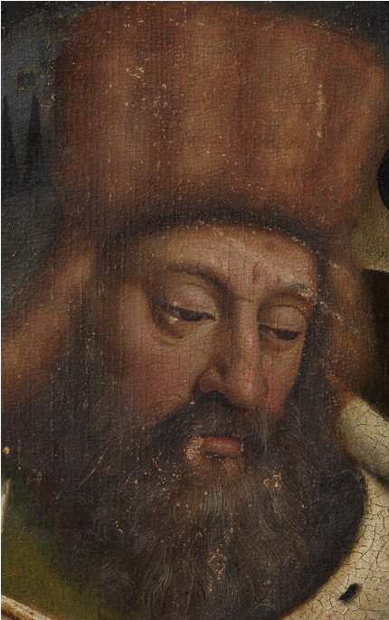
Single modality
LR
SRC
SVM
Image after cleaning

Slide 3
Single modality/features
LR
Image after cleaning
SVM
SRC

Slide 4
Multiple modalities/features
Image after cleaning
LR
SVM
SRC
Notes:
On the Face, wrong detection.

Slide 5
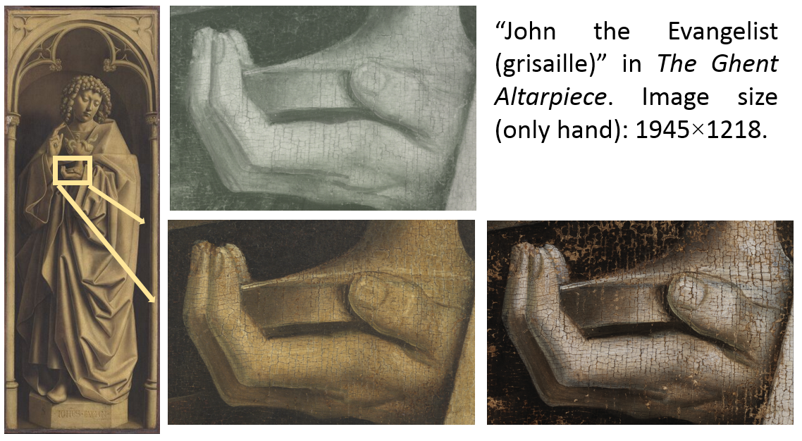
Example 2

Slide 6
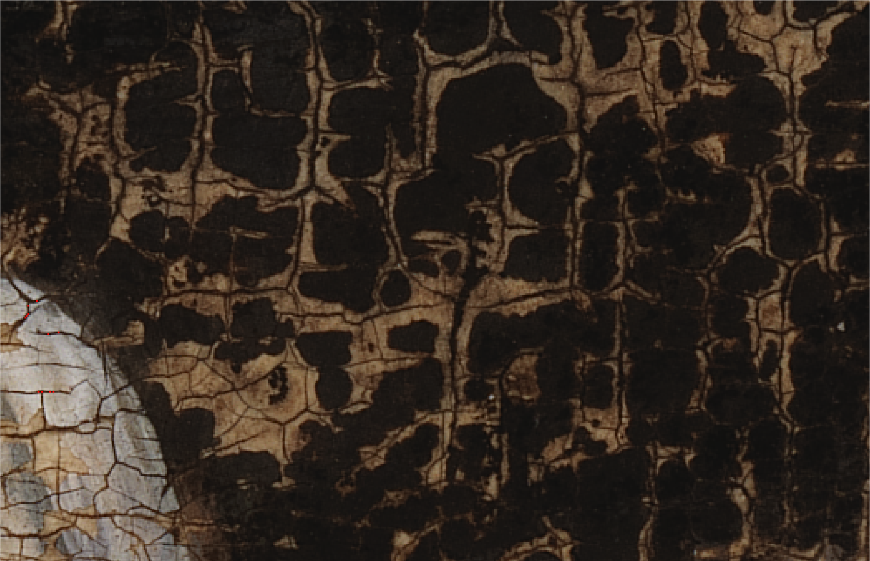
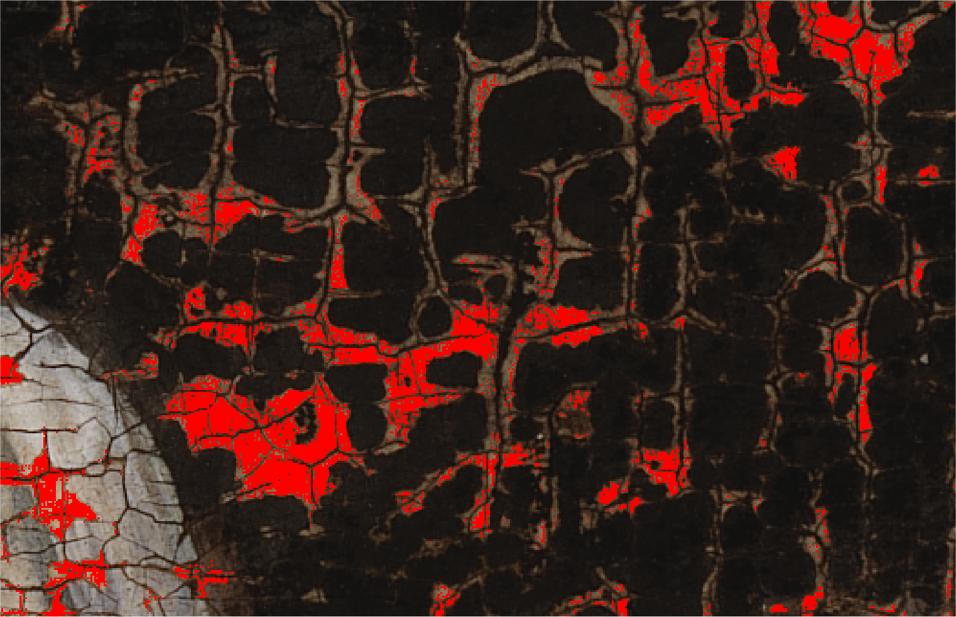
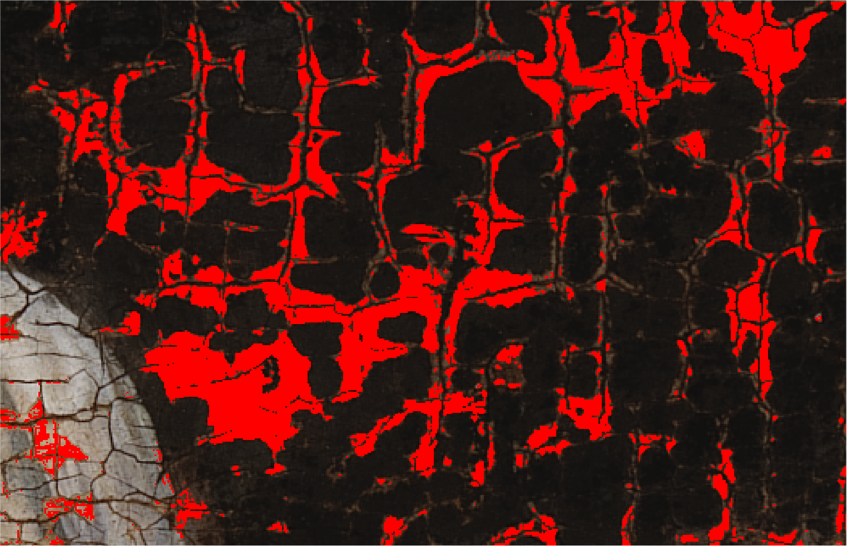
Linear regression results
Original
Single modality
Single modality and features
Multiple modalities and features

Slide 7
Multiple modalities/features
Original
LR
SVM
SRC

Slide 8
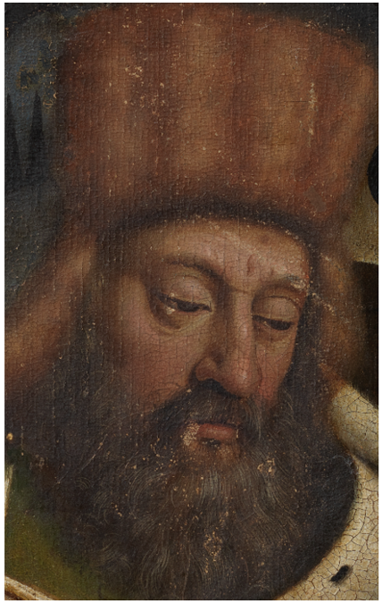
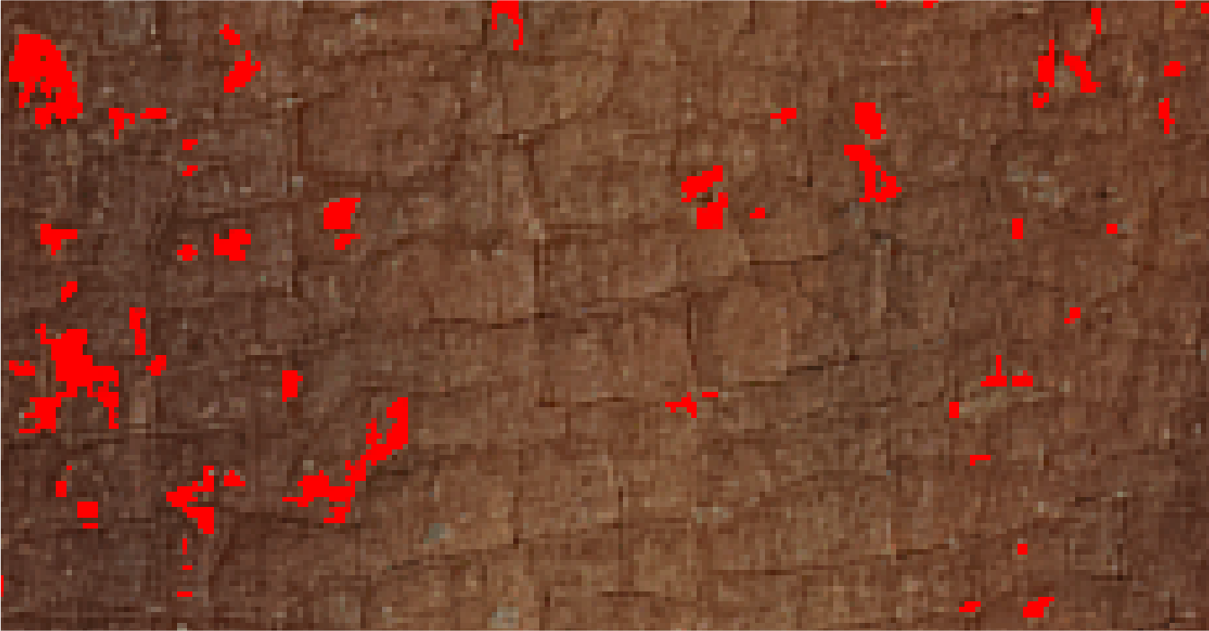
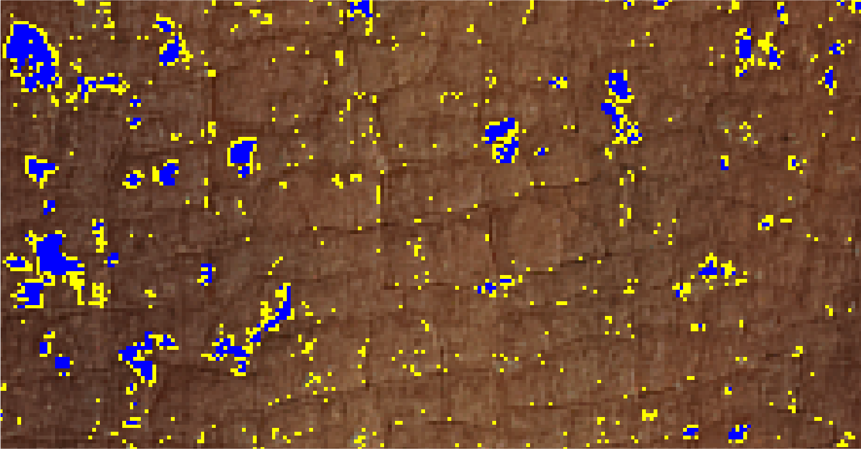
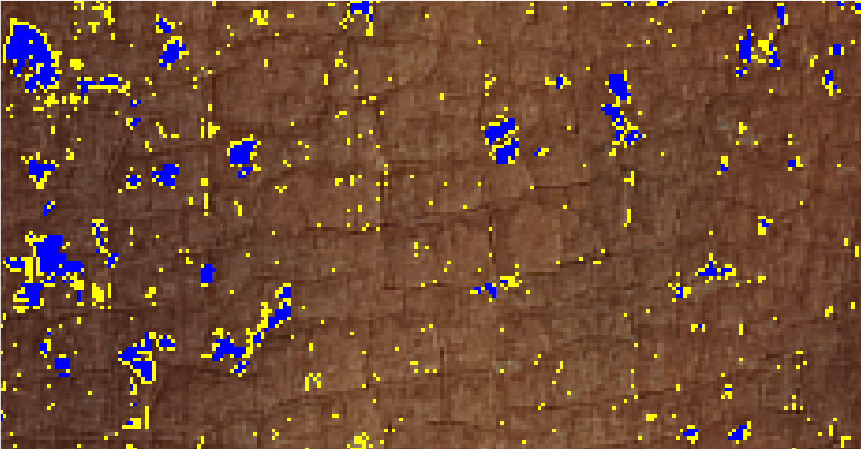
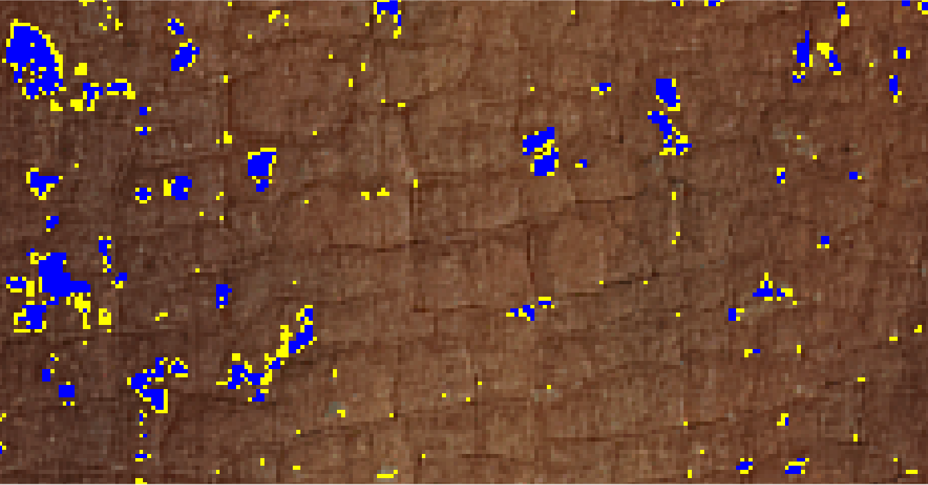
Effectiveness of iterated detection
Ground truth
Size 1600, 1 iteration
Size 16000,1 iteration
Size 1600, 10 iterations
Overlay of SRC results with ground truth;
Size refers to dictionary size

Slide 9
Outline
Problem
Sparse representation classification
Paint loss detection method
Evaluation
Conclusion

Slide 10
Conclusion
Applying SRC to paint loss detection required solving specific problems in terms of feature generation and unreliable labeled samples.
A practical SRC-based method with spatial features and iterated detection was developed.
SRC is promising in this application
Suffers less from under detection than SVM and LR.
Limitation: High complexity.

Slide 11
Future work
Extensive quantitative evaluation.
Explore benefit from joint sparsity.
Explore dictionary learning in this framework.

Slide 12
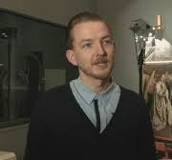
Contributors
http://ipi.ugent.be/ Email: Shaoguang.Huang@ugent.be

